Slide 1
Problem Reduction Search
AND/OR Graphs (AO* Algorithm)

Slide 2
Problem Reduction Search
Planning how best to solve a problem that can be recursively decomposed into sub problems in multiple ways.

Slide 3
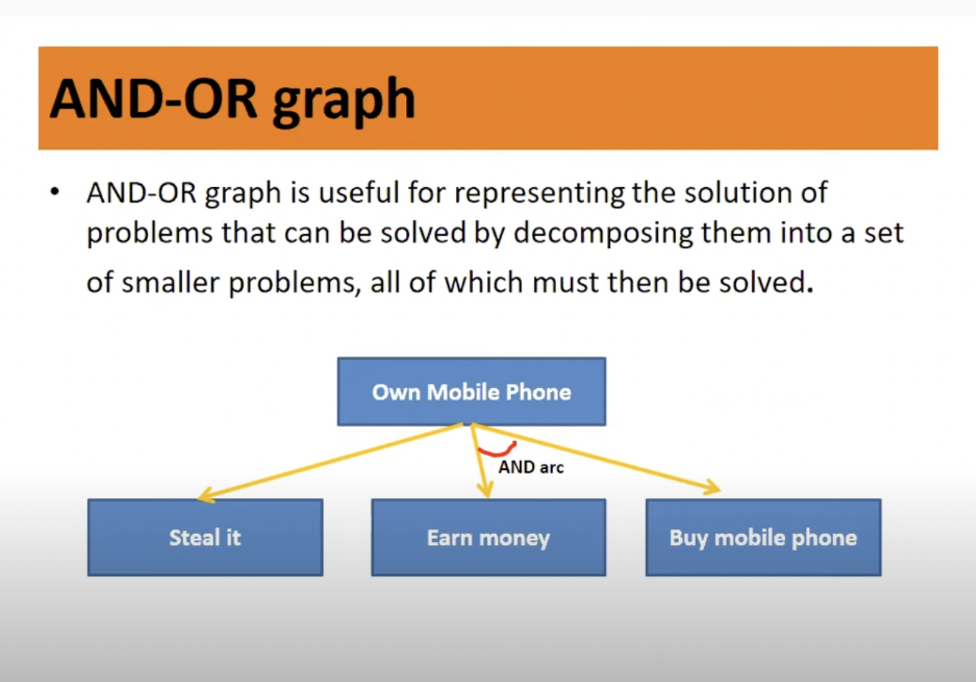

Slide 4
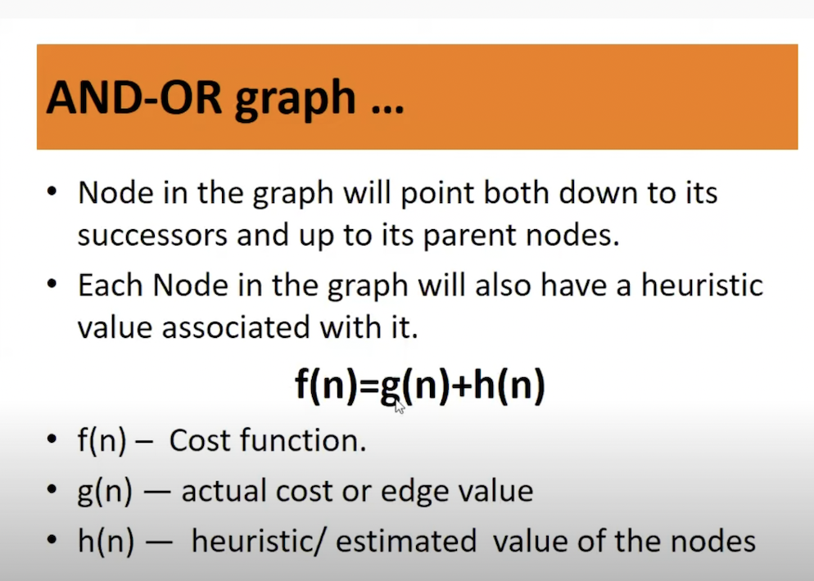

Slide 5
Formulations
AND/OR Graphs
  An OR node represents a choice between possible decompositions
  An AND node represents a given decomposition
Game Trees
  Max nodes represent the choice of my opponent
  Min nodes represent my choice

Slide 6
AND/OR Graph Search Problem
Problem definition:
  Given: [G, s, T, h] where:
    G: implicitly specified AND/OR graph
    s: start node of the AND/OR graph
    T: set of terminal nodes
    h(n): heuristic function estimating the cost of solving the sub problem at n
To Find:
  Minimum Cost Solution Tree

Slide 7
AND
h=7

Slide 8
AND
h=7 10
2
1
OR
h=4
OR
h=3

Slide 9
AND
h=10
2
1
OR
h=4
OR
h=3
1
1
T
h=8
h=6
T

Slide 10
AND
h=10 14
2
1
OR
h=4
OR
h=3 7
1
1
T
h=8
h=6
T

Slide 11
AND
h=14
2
1
OR
h=4
OR
h= 7
1
1
2
1
T
h=8
AND
h=2
AND
h=5
h=6
T

Slide 12
AND
h=14
2
1
OR
h=4
OR
h= 7
1
1
2
1
T
h=8
AND
h=2 14
AND
h=5
h=6
T
0
h=10
1
OR
OR
h=3

Slide 13
AND
h=14
2
1
OR
h=4 16
OR
h= 7
1
1
2
1
T
h=8
AND
h=14
AND
h=5
h=6
T
0
h=10
1
OR
OR
h=3

Slide 14
AND
h=14
2
1
OR
h=16
OR
h= 7
1
1
2
1
T
h=8
AND
h=14
AND
h=5
h=6
T
0
h=10
1
OR
OR
h=3

Slide 15
AND
h=14
2
1
OR
h=16 6
OR
h= 7
1
1
2
1
T
h=8
AND
h=14
AND
h=5
h=6
T
0
h=10
1
OR
OR
h=3

Slide 16
AND
h=14 16
2
1
OR
h=6
OR
h= 7
1
1
2
1
T
h=8
AND
h=14
AND
h=5
h=6
T
0
h=10
1
OR
OR
h=3

Slide 17
AND
h=16
2
1
OR
h=6
OR
h= 7
1
1
2
1
T
h=8
AND
h=14
AND
h=5
h=6
T
0
1
h=10
1
T
1
T
h=3
OR
T
h=2
h=3

Slide 18
AND
h=16
2
1
OR
h=6
OR
h= 7
1
1
2
1
T
h=8
AND
h=14
AND
h=5 7
h=6
T
0
1
h=10
1
T
1
T
h=3
OR
T
h=2
h=3

Slide 19
AND
h=16
2
1
OR
h=6 8
OR
h= 7
1
1
2
1
T
h=8
AND
h=14
AND
h=7
h=6
T
0
1
h=10
1
T
1
T
h=3
OR
T
h=2
h=3

Slide 20
AND
h=16 18
2
1
OR
h=8
OR
h= 7
1
1
2
1
T
h=8
AND
h=14
AND
h=7
h=6
T
0
1
h=10
1
T
1
T
h=3
OR
T
h=2
h=3

Slide 21
h=18
AND
2
1
OR
h=8
OR
h= 7
1
1
2
1
T
h=8
AND
h=14
AND
h=7
h=6
T
0
1
h=10
1
T
1
T
h=3
OR
T
h=2
h=3

Slide 22
h=18
AND
2
1
OR
h=8
OR
h= 7
1
1
2
1
T
h=8
AND
h=14
AND
h=7
h=6
T
0
1
h=10
1
T
1
T
h=3
OR
T
h=2
h=3
Now all the leaf nodes of the marked
tree are solved. Thus solve each sub
problem(node) at marked sub tree.

Slide 23
AO* Algorithm
Initialize: Set G* = {s}, f(s) = h(s)
  if s ∈ T, label s as SOLVED
Terminate:
if s is SOLVED, then Terminate
Select: A non-terminal leaf node n from the marked sub tree.
Expand: Mark explicit the successors of n For each new successor m:
set f(m) = h(m)
if m ∈ T, label m as SOLVED

Slide 24
AO* Algorithm
Cost Revision: Call cost-revise(n)
Loop: Goto step 2

Slide 25
Cost Revisoin in AO* cost-revise(n)
Create Z={n}
If Z = { } then return
Select the node m from Z such that m has no descendants in Z
If m is an AND node with successors R1, R2, R3, …….. Rk
  set f(m) = Σ [f(Ri) + C(m,Ri)]
  Mark the edge to each successor of m
  if each successor is labeled SOLVED then label m as SOLVED

Slide 26
Cost-revise(n)
If m is an OR node with successors R1, R2, R3, …….. Rk
  set f(m) = min [f(Ri) + C(m,Ri)]
  Mark the edge to best successor of m
  if marked successor is labeled SOLVED then label m as SOLVED
If the cost or label of m has changed, then insert those parents of m into Z for which m is a marked successor
Goto step 2

Slide 27
Searching OR Graph
How would AO* behave when we have only OR nodes ????

